Slide 1
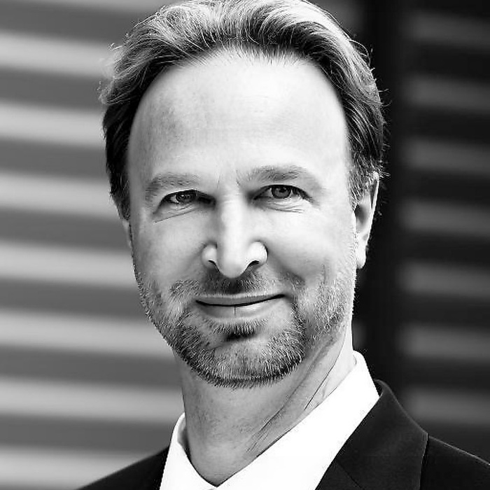
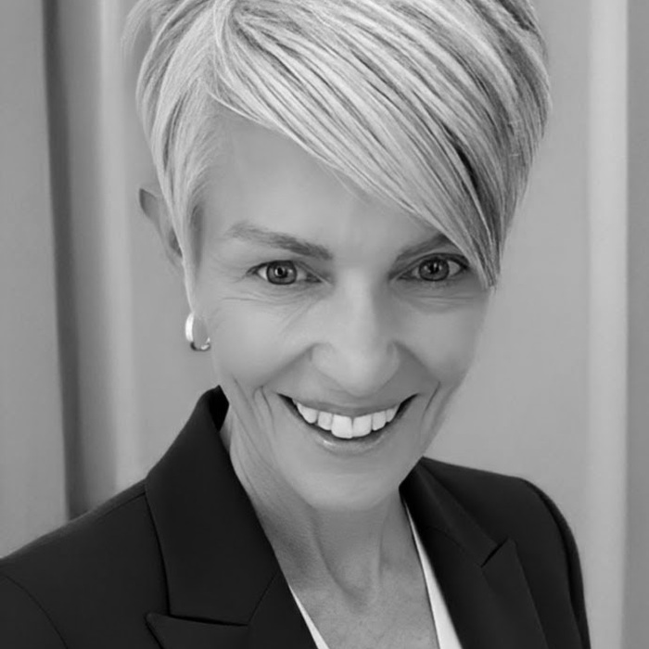
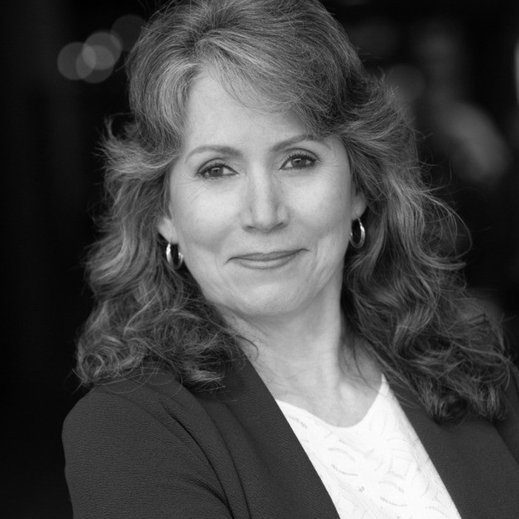
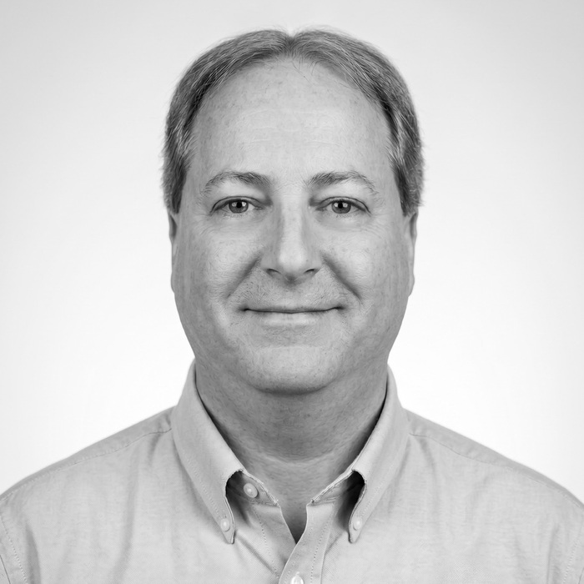
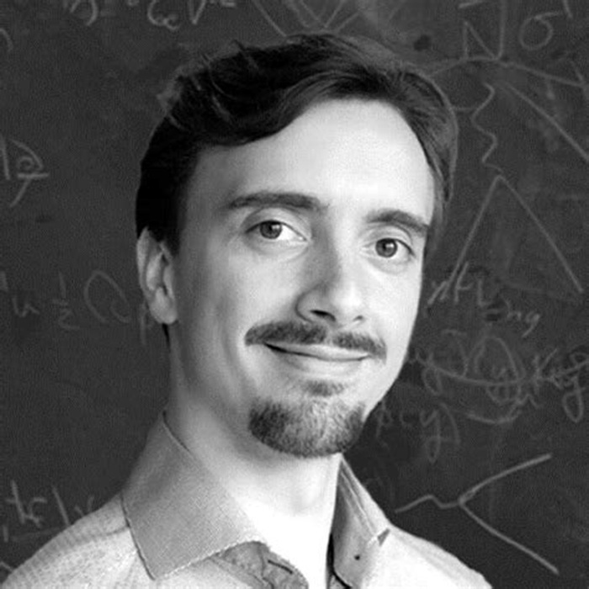
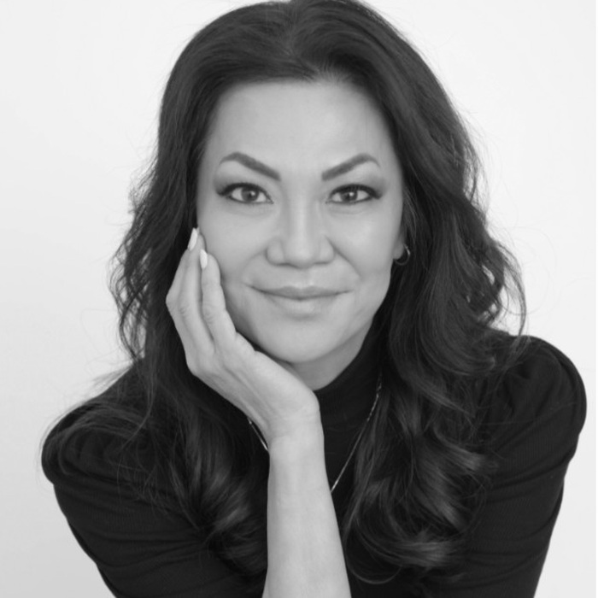
APPENDIX
qAI37 Core Team Details (Page 1 of 2)
Michelle Holtmann
Vicki Mitchell
Ted Stockwell
Founder & CEO
President & Chief Strategy Officer
Chief Engineering Officer
Former GM, Microsoft Online Services Division. Built Bing as a Platform. Founded qAI37 in 2022.
Former GM, Microsoft; designed Software Protection Platform, former software engineer Boeing Commercial Airplane Group.
Former VP Engineering, Google, ARM, Altera. Designed ARM's instruction sets; built configurable hardware at Altera.
Steve Jahnke
Vincent Elfving
Laverne Masaki
Chief Technical Officer & Principal Architect
Chief Quantum Advisor
Chief People Officer
30 years, Intel, Altera, TI. 24 patents. Owns Translation Layer & HAL architectures.
Former Head of Algorithms, Pasqal (40+ researchers); PhD, Quantum Information Processing; Google Quantum AI alumnus.
Former executive recruiter, Microsoft and Google.
qAI37
A7

Slide 2
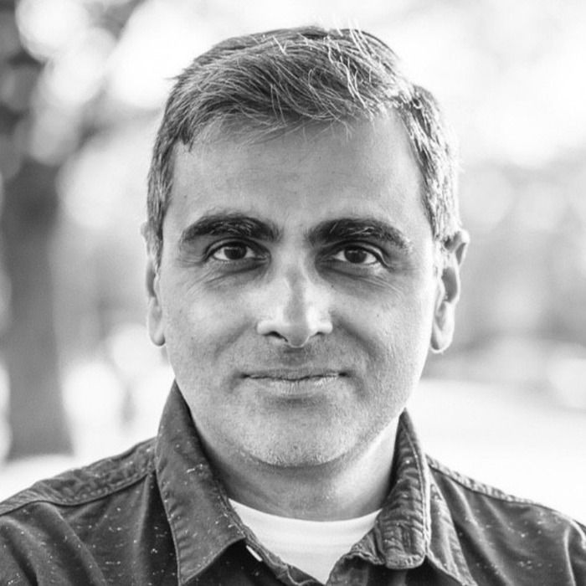
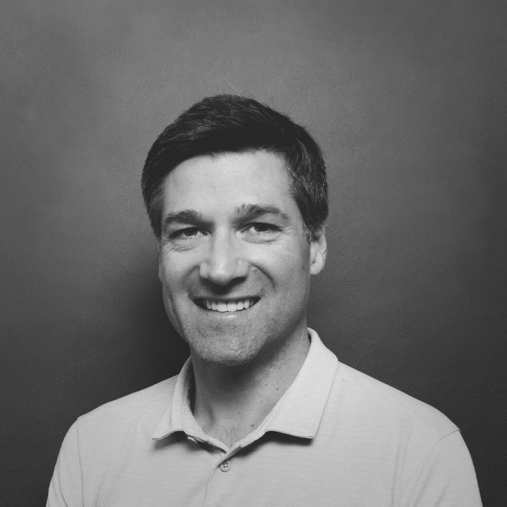
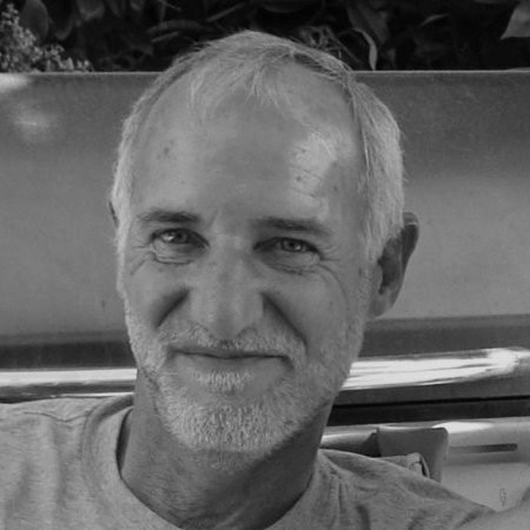
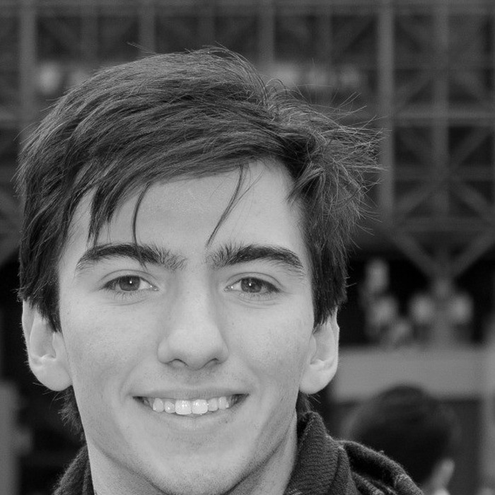
APPENDIX
qAI37 Core Team Details (Page 2 of 2)
Gregor Barry
Rick Jahnke
Rupesh Srivastava
Quantum Advisor
Advisor
Principal Engineer
Managing Director, Accenture, Toronto — twelve years in enterprise relationships, Fortune 500 clients.
30+ years embedded systems engineering; Director of Engineering, Galixsys Networks; named inventor, embedded network patents.
PhD Physics, Royal Holloway, University of London; five years developing the UK quantum-computing ecosystem at Oxford's Department of Physics; Chief Quantum Officer, Entangled Positions.
Ruben Marroquin
Senior Engineer
FPGA/embedded systems engineer, Intel and Altera; patent strategy, hardware applications engineering; BS EE, Rice University.
qAI37
A8

Slide 3
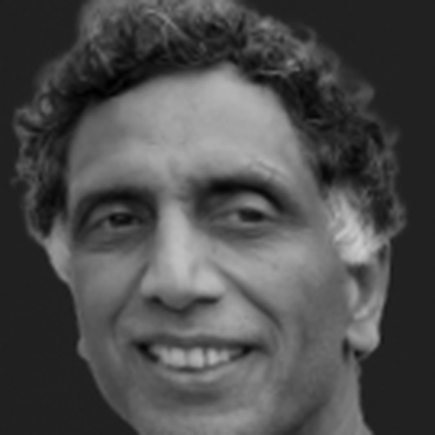
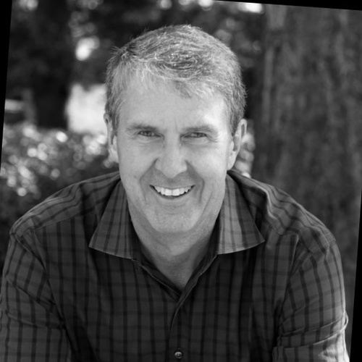
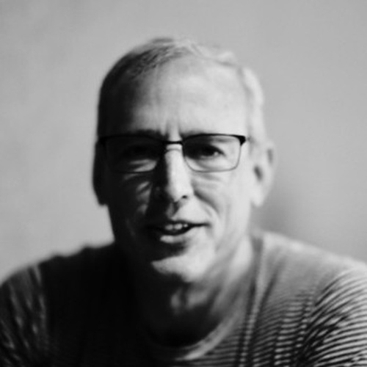
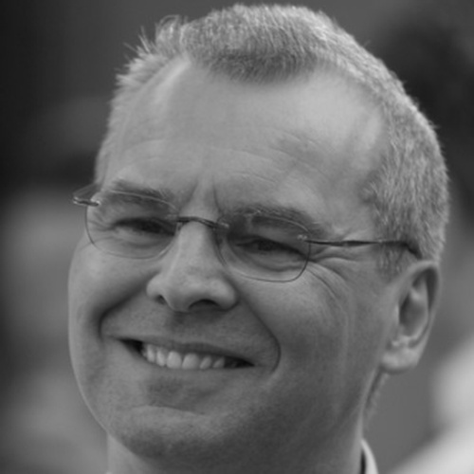
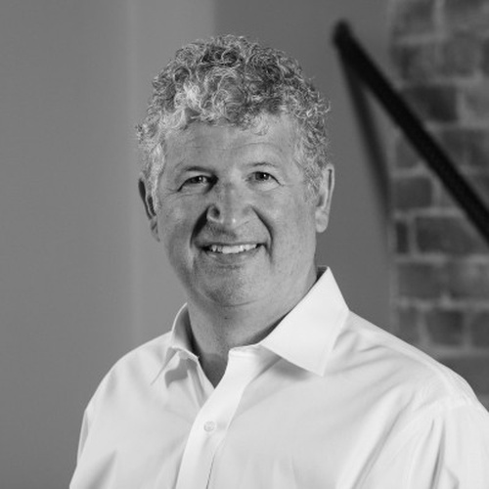
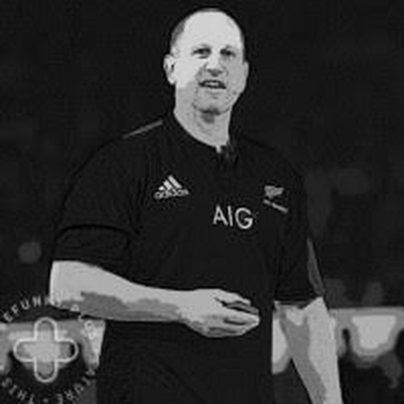

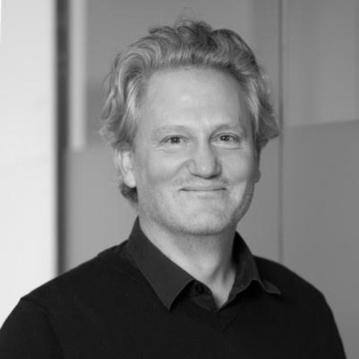
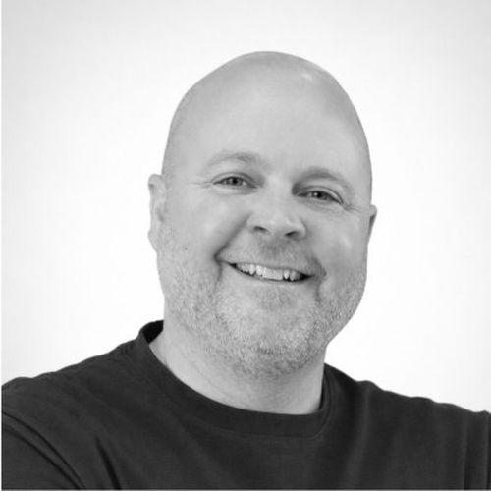
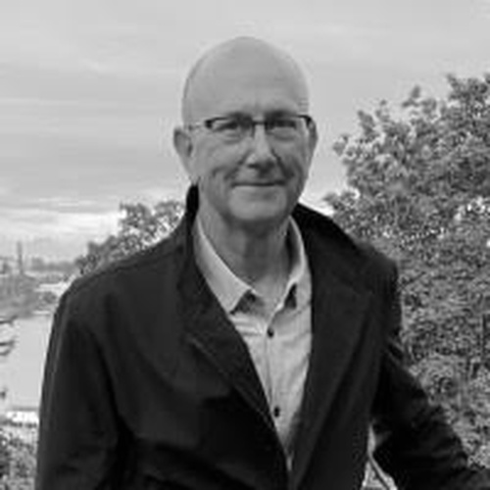
Advisory Board & Scientific Associations
Sethu Raman
Robbie Bach
Chris Phillips
Bill Laing
Darren Huston
Technical Advisor
Strategic Advisor
Strategic Advisor
Strategic Advisor
Strategic Advisor
Former Distinguished Engineer, Apple & Microsoft.
Former Microsoft President, Entertainment & Devices.
Global tech strategist. Former Microsoft SVP, Server & Tools.
Technical lead, large-scale systems. Former Microsoft CVP, Windows Server & Azure.
Former CEO, Booking.com. Former President, Microsoft Japan.
Steve Guggenheimer
John Williams
Luke Minford
Richard Wood
Shawn Bohnert
Strategic Advisor
Strategic Advisor
IP & Legal Advisor
AI Investment Principal
Board Member
Former Microsoft CVP, Developer Platform.
Former architect and executive at AMD, Cray, Microsoft, and Google.
CEO, Rouse UK — co-leading global IP house.
First Hill Partners — strategic fundraising advisor.
Early investor and SAFE mechanics advisor.
qAI37
SLIDE 19

